Slide 1
LIVEWELL INITIATIVE (LWI)
…promoting wellness
...preventing ill health
A Sustainable Non-Government Organization
Offering Health Promotion
Our Success Story 2014

Slide 2
Presentation Overview
Who are we?
What do we do?
How did we become sustainable?
What next?
www.livewellng.org

Slide 3
Who Are We?
LiveWell Initiative LWI is a self-sustaining healthcare NGO registered in Nigeria (RC: 692490)
LWI’s vision is to “half health illiteracy in Africa by 2030” thereby increasing life expectancy to 70 years
LWI is a community-based organization with a national orientation and international outlook
LWI’s ‘niche’ is promoting health literacy and wellness and increasing life expectancy through health empowerment
www.livewellng.org

Slide 4
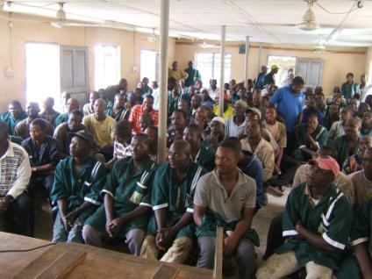
Why Health Literacy?
Health literacy
is very low in society
has no direct relationship to socio-demographic status and educational attainment
Health illiteracy results in
increased morbidity/mortality
preventable deaths
Health literacy can be achieved through the informal sector….
is well organised with its own structure and hierarchies
is seemingly better organised than the formal private health sector
www.livewellng.org

Slide 5
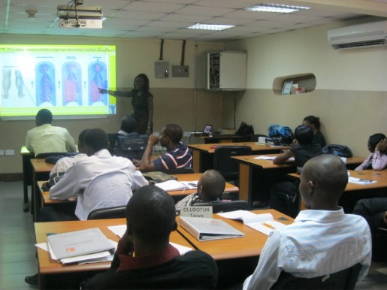
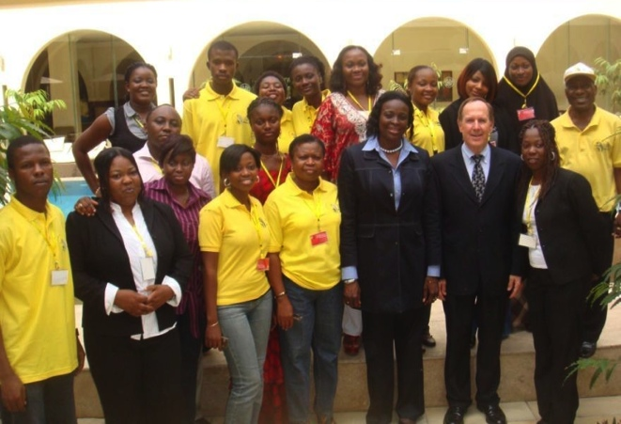
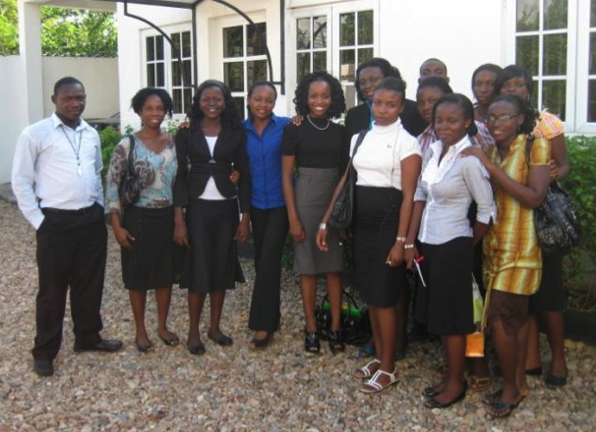
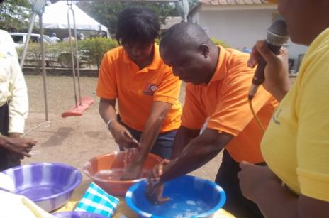
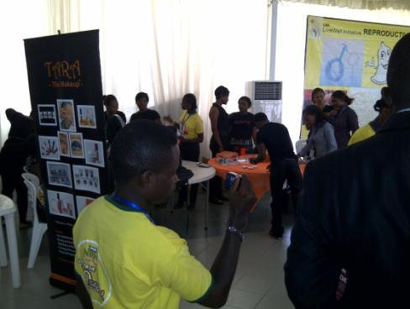
What Do We Do? Offer highly valued services to “paying” customers
Community Health Initiatives
Workplace Wellness
EasyHealth (home healthcare)
Capacity Development
Customised Trainings
Health Fairs
World Health Day Celebrations
Grand Health Bazar
Health Related Focus Groups
www.livewellng.org

Slide 6
Key Areas of Impact – bottom-of-the-pyramid populations
LWI works with the bottom-of-the-pyramid populations: the Urban Poor, Rural Poor, and the Working Poor
LWI has impacted the lives of over 1.5 million Nigerians including over 400 disabled adults, and over 3,000 Ghanaians directly and indirectly by proxy contact.
LWI reaches out to the underserved and less-privileged in the society, at taxi parks, markets and mechanic parks.
We are currently creating awareness on such issues as Hepatitis and Maternal, Newborn & Child Health MNCH through partnerships and forums such as the LWI Strategic Focus Group Meeting SFGM.
www.livewellng.org

Slide 7
LWI Programme Coverage
Markets
Villages
Schools
Settlements
Taxi Parks
Mechanics’ Workshops
Conglomerates
Banks
Rural areas
Semi-Urban areas
Urban areas
Conferences / Exhibitions
Forums
Health Fairs
Corporates
Organised gatherings
www.livewellng.org

Slide 8
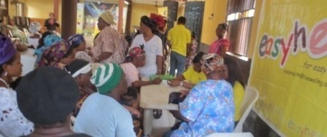
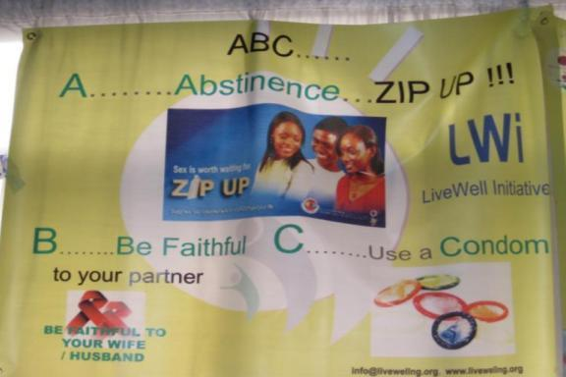
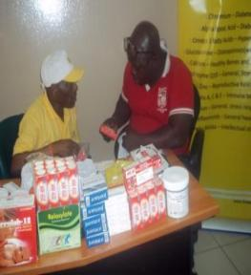
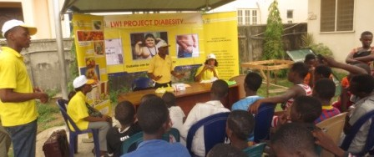
Who Do We do? So we deliver free services in communities
Illness Poverty Alleviation Programme (IPAP)
Malaria Eradication Programme (MEP)
HIV/AIDS Enlightenment Programme (HAEP)
Executive Health Enlightenment Scheme (EHES)
Drug Use, Abuse, Disuse Enlightenment Scheme (DUADES)
www.livewellng.org

Slide 9
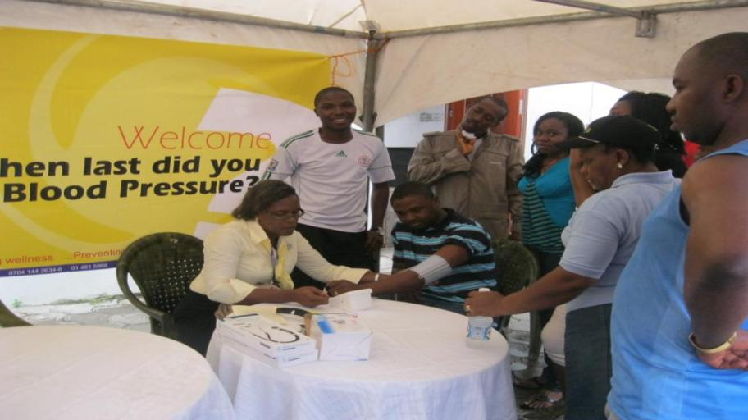
LWI Services
More than health promotion – Continuum of Care approach that offers:
Basic Biometric Tests e.g. Stress, BP, Sugar, BMI, WHR, other tests as requested and agreed
Personalised Nutritional and Lifestyle health counselling
Non-prescription medicines and assistance to fill prescriptions where necessary
Basic Cancer Screenings – breast, cervical and prostate
Hepatitis B, Malaria Screening and VCT for HIV/AIDS
Collaborations with proven specialists
Consultation and referrals to free, non-fee paying health clinics or appropriate health institutions where necessary

Slide 10
How Did We Become Sustainable?
LWI Business Model
Strategic decision at beginning NOT to see donor funds
Board advised LWI learn to live within means during first 5 years
Three principal sources of income cover all costs
Membership dues: Three categories priced on a sliding scale 1) student 2) individual (regular/executive) and 3) corporate membership
Honoraria: Corporate contributions priced at cost/below cost to deliver services
Academy: Formal (LWI partnership with academic institutions) and informal internships (LWI internships) contribute nominal amount
Also receive in-kind donations to defray operating costs
Honorarium Paying clients
Subsidize community services delivered for free
Cost Recovery
Cross Subsidization
www.livewellng.org

Slide 11
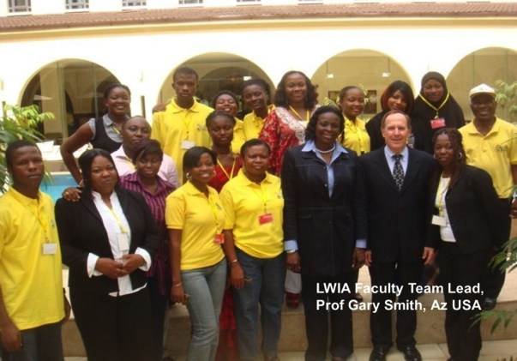
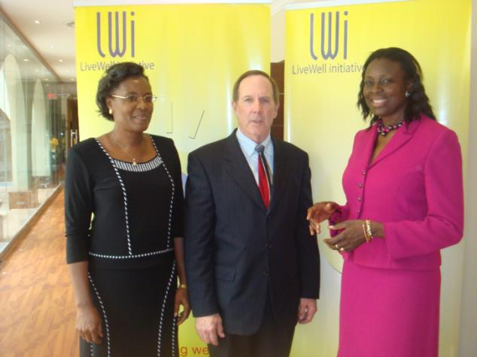
How Did We Become Sustainable? Cont’d
1st Step – Developed 5 Year Business Plan with clear focus and achievable goals
Focused on building client base and generating income
At first, Two sources of income: (1) Membership and (2) Honoraria
Added new product in response to client demand: Corporations requested training offered to LWI staff but tailored to own staff >>>LWI Academy – Inaugurated Feb 10th 2011<<<

Slide 12
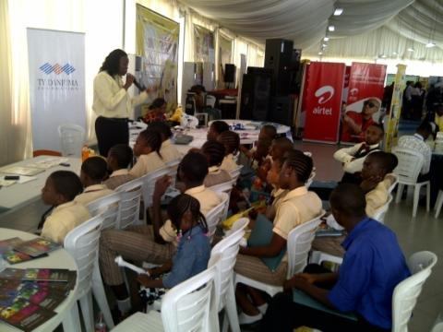
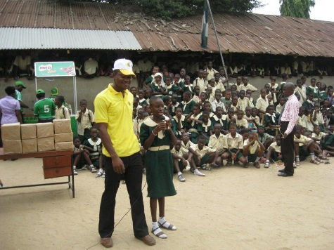
How Did We Become Sustainable? Cont’d
2nd Step: Identified niche and opportunities for growth in new 5 Year Business Plan
Focus on improving/expanding old products while creating new ones
Old Products: Expand Annual Public Health Fairs and Global Health Bazars, Celebration of World Health Days
New Products: Evolve Easy Health to Home Hospital and Establish Trauma Counselling Unit
Expand through strategic partnership and donor funding
Build a physical plant to house the Academy
Open offices in Uganda, UK and US by 2017
www.livewellng.org

Slide 13
How Did We Become Sustainable? Cont’d
Lessons learned on path to sustainability
LWI used a deliberate strategy to enter into market
Delivered limited range of products to “paying” clients that offered value to corporations
Offered “flexible” pricing to attract new clients and retain them
Initially offer free or heavily subsidized honoraria
Over time, increase prices >>> at cost or slightly below
LWI expanded its services slowly according to financial means
Stuck to budget (met payroll, paid stipends to volunteers, covered all activity costs)
Only expanded/increased activities when finances were available
LWI also moved quickly to respond to new opportunities
www.livewellng.org

Slide 14
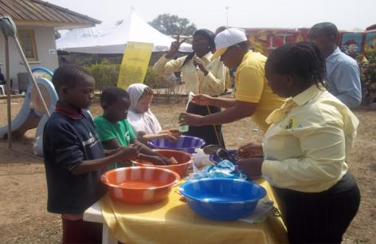
Partnership with GSK
GSK Orange Day Project 2011
Comprehensive Rural Community Health Initiative for Onireke Community Ibadan
Delivered free healthcare services, screening and medicines to vulnerable children (OVCs) and villagers
GSK paid honoraria for services
GSK Vaccines Project
GSK Immunisation Access Initiative, 2009 and 2011
GSK Neighbourhood Vaccines Project 2012
LWI trained pharmacists, doctors, nurses nationwide to participate in vaccine projects
GSK part-paid training fees while recipients paid the subsidised balance
www.livewellng.org

Slide 15
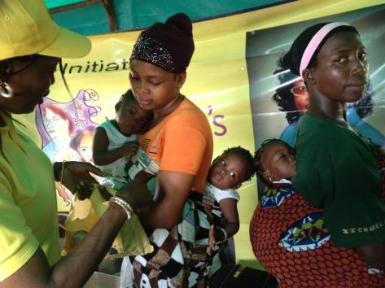
Partnership with Soroptimists Int’l Club
LWI organized:
December 2009: Award-Winning World AIDS Day Programme
Ojota Motor Park Women’s Health Programme on World AIDS Day
July 2012: Maternal and Child Health Programme
Women’s Health Screening and Health Outreach at Onigbongbo Market, Lagos
Oct 2013: Breast & Cervical Cancer Screening for women at Awolowo Market, Mushin
Oct 2013 LWI Award-Winning IAPO PSD2013 Photo Contest depicts TRIPETS at the LWI Rural Health Mission Ipokia Ogun State Nigeria
www.livewellng.org

Slide 16
Results from LWI Approach
LWI has successfully reached the bottom-of-the-pyramid population groups (e.g. urban and rural poor, working poor)
LWI has impacted the lives of over 1.5 million Nigerians in the country’s 6 Geo-Political zones
Including over 400 disabled adults, thousands of school aged children and thousands of women
LWI has reached over 3,000 Ghanaians at their doorstep, Accra city
LWI has pioneered proven approaches to reach BOP at places such as taxi parks, markets and mechanic parks
LWI has helped address HRH shortages in Nigeria
Trained over 800 Alumni in short course and healthcare skills
Develops healthcare capacity in Immunisation Training, HIV/AIDS Care and Counselling , Wellness Champions, First CPR and Diabetes Educators’ Training among several others
www.livewellng.org

Slide 17
What next for LWI?
LWI is financially and organizationally ready to grow
LWI is poised to upgrade to Home Hospital Care System in 2015
LWI has established base of partnerships with state and federal governments and private sector on which to grow in more geopolitical zones in Nigeria
LWI is exploring a partnership with an NGO in Uganda, to establish its first out-of-country office
LWI is exploring partnership possibilities with would-be-partners, to replicate its model in other countries
LWI wishes to establish an Academy Plant where donor land exists
www.livewellng.org

Slide 18
Thank You LWI… Today’s HOPE for Tomorrow’s Healthcare LWI …Live Well …Live Long! Please visit our website at www.livewellng.org Follow us on Twitter @L_W_I Like us on Facebook at www.facebook.com/LiveWell.Initiative.LWI

