Slide 1
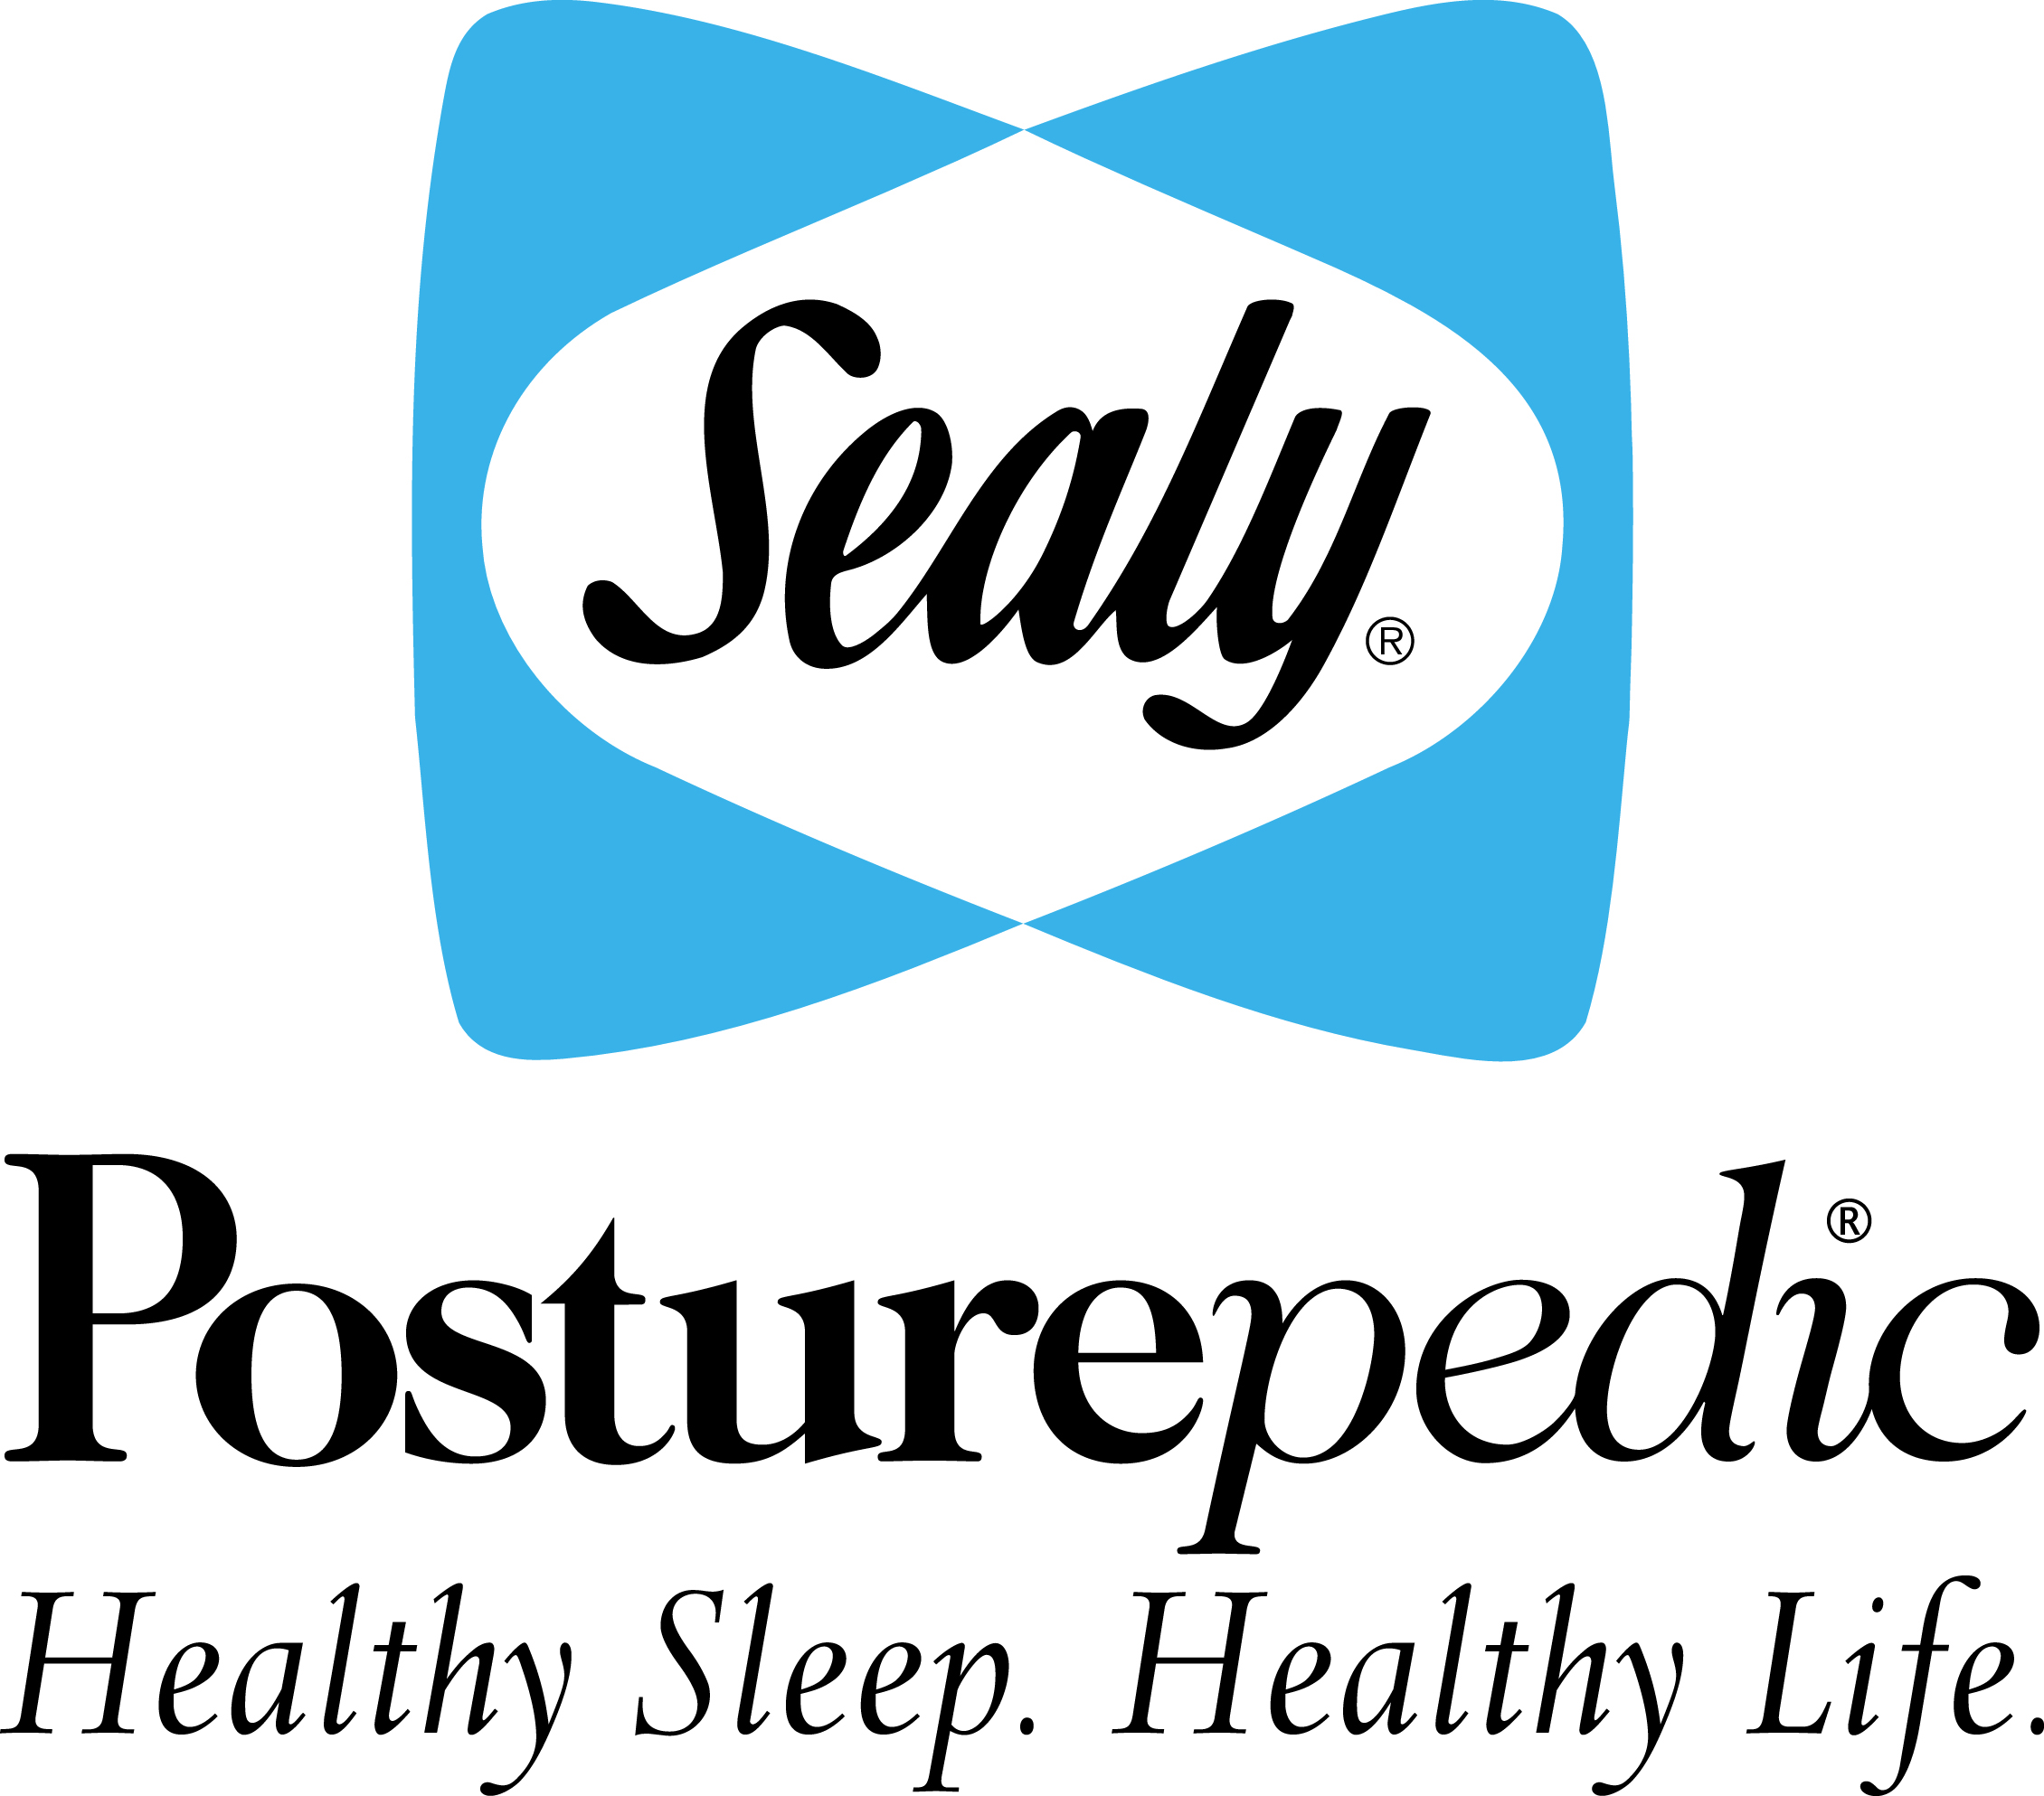

Slide 2
BENEFITS OF A GOOD NIGHT’S SLEEP
Adequate sleep is a key part of a healthy lifestyle, and can benefit your heart, weight, mind, and more.
Sleep also affects quality of life.
If you’re an athlete, there may be one simple way to improve your performance: sleep.
College students who didn’t get enough sleep had worse grades than those who did.
Children ages seven and eight who got less than about eight hours of sleep a night were more likely to be hyperactive, inattentive, and impulsive.
Sleep can definitely reduce levels of stress.
Insufficient sleep for just one night can be detrimental to your driving ability.
A good night’s sleep can really help a moody person decrease their anxiety.
You get more emotional stability with good sleep.

Slide 3
BENEFITS OF A SEALY POSTUREPEDIC !
To live healthy, we need to SLEEP HEALTHY too!
We spend a 1/3 of our lives in bed!
Ensuring we get the best quality sleep is vitally important.
That’s why Sealy Posturepedic is designed in co-operation with leading orthopaedic surgeons to ensure the correct support where the body needs it most.

Slide 4
BENEFITS OF A SEALY POSTUREPEDIC !
The quality of your day can be influenced by the quality of your sleep. And the quality of your sleep can be influenced by how restful and comfortable your bed is.
Sealy Posturepedic sleep systems combine the latest advances in innerspring and comfort technologies to engineer a sleep system that delivers the level of rest and comfort your need to help you rise and shine everyday!
It’s an evolution in comfort and support!

